Slide 1

Learning Robust Reward Machines from Noisy Labels
Roko Parac, Lorenzo Nodari, Leo Ardon, Daniel Furelos-Blanco, Federico Cerutti, Alessandra Russo
Presented by Zi-Long Wang
2024-11-05

Slide 2






Authors
Roko Parac
Imperial College London
Reward Machines (RMs), reinforcement learning, neuro-symbolic learning

Slide 3
Background

Slide 4
Reward Machine
Reward machine consists of a finite state machine (FSM) and state-reward function
Each state represents a particular situation or condition in the environment, and transitions describe the agent's movements between states.
A reward machine allows for composing different reward functions in flexible ways

Slide 5
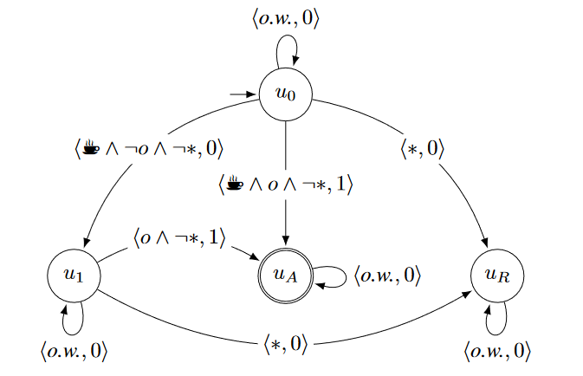
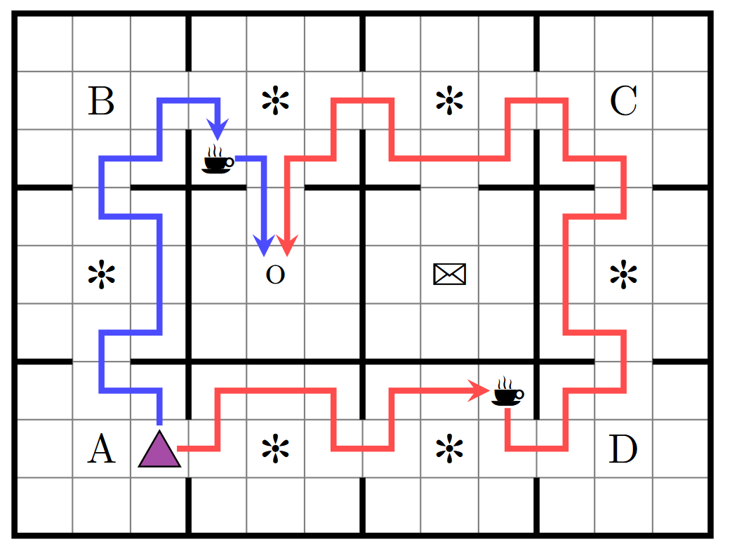
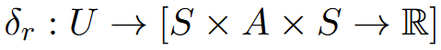
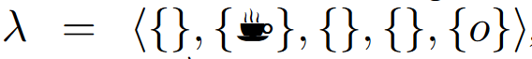
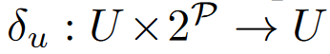
Reward Machine
Reward Machine
state-reward function：
state-transition function:

Slide 6
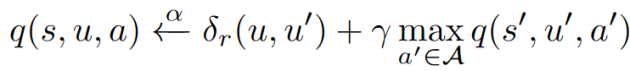
Reward Machine
Reward Machine
Q-function:

Slide 7
Reward Machine
Reward Machine
RM learning approaches assume a perfect labelling function, a construct that enables agents to accurately observe the highlevel events occurring in the environment. This assumption is unrealistic

Slide 8
Probabilisitic Induction of Reward Machines （PROB-IRM)

Slide 9
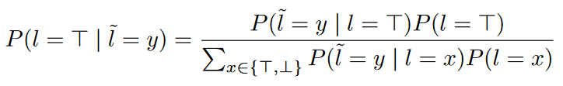
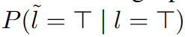
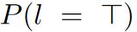
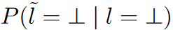
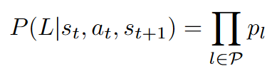
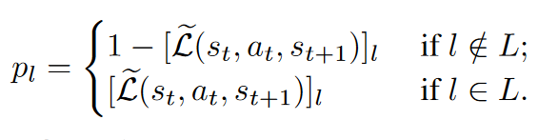
1. Noisy Traces
sensitivity of the sensor:
specificity of the sensor:
prior probability:
Noisy labelling function:
Noisy trace:

Slide 10
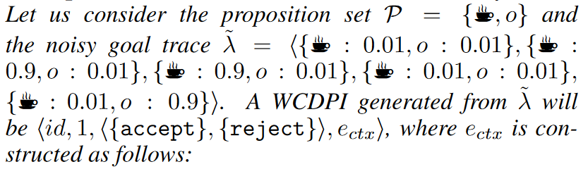
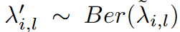
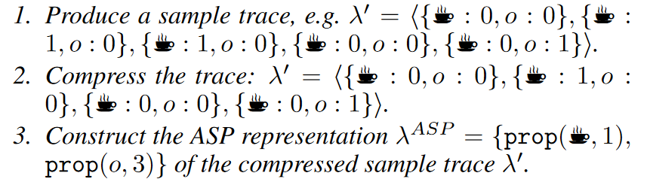
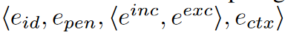
Learning RMs from Noisy Traces
Generating Examples from Noisy Traces:
Compress the trace
Construct the ASP representation
WCDPI example:

Slide 11
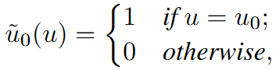
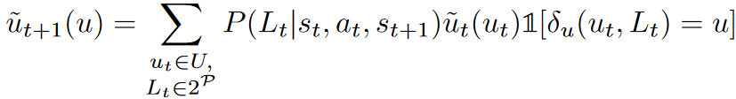
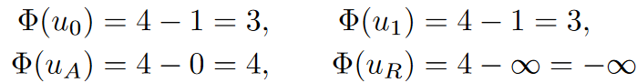
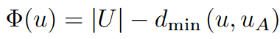
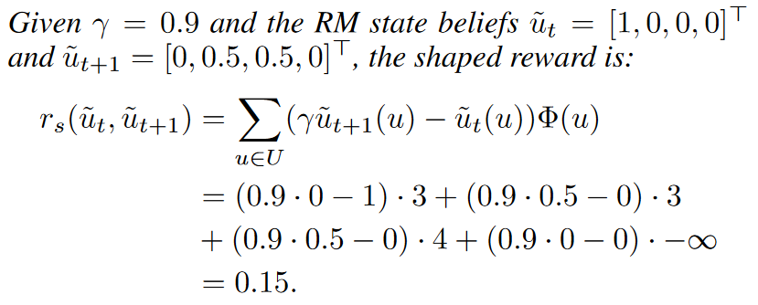
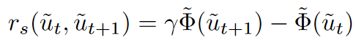
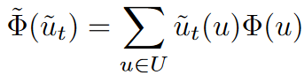
Exploitation of Reward Machines
Reward Machine State Belief:
categorical probability distribution expressing the RL agent’s belief of being in an RM state u at timestep t
Probabilistic Reward Shaping:

Slide 12
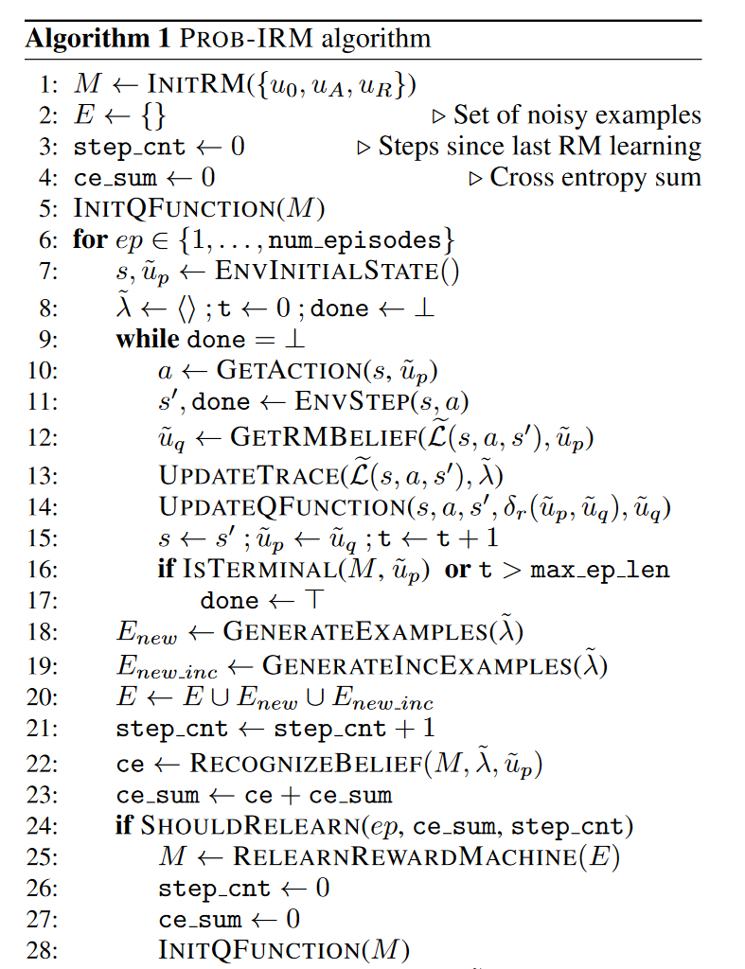
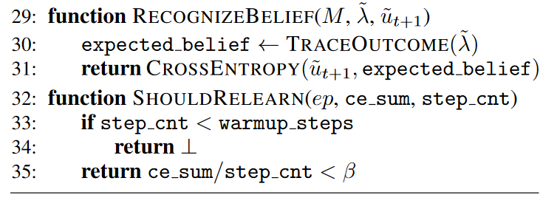
Interleaved Learning Algorithm

Slide 13
Interleaved Learning Algorithm

Slide 14
Interleaved Learning Algorithm

Slide 15
Interleaved Learning Algorithm

Slide 16
Experiment

Slide 17
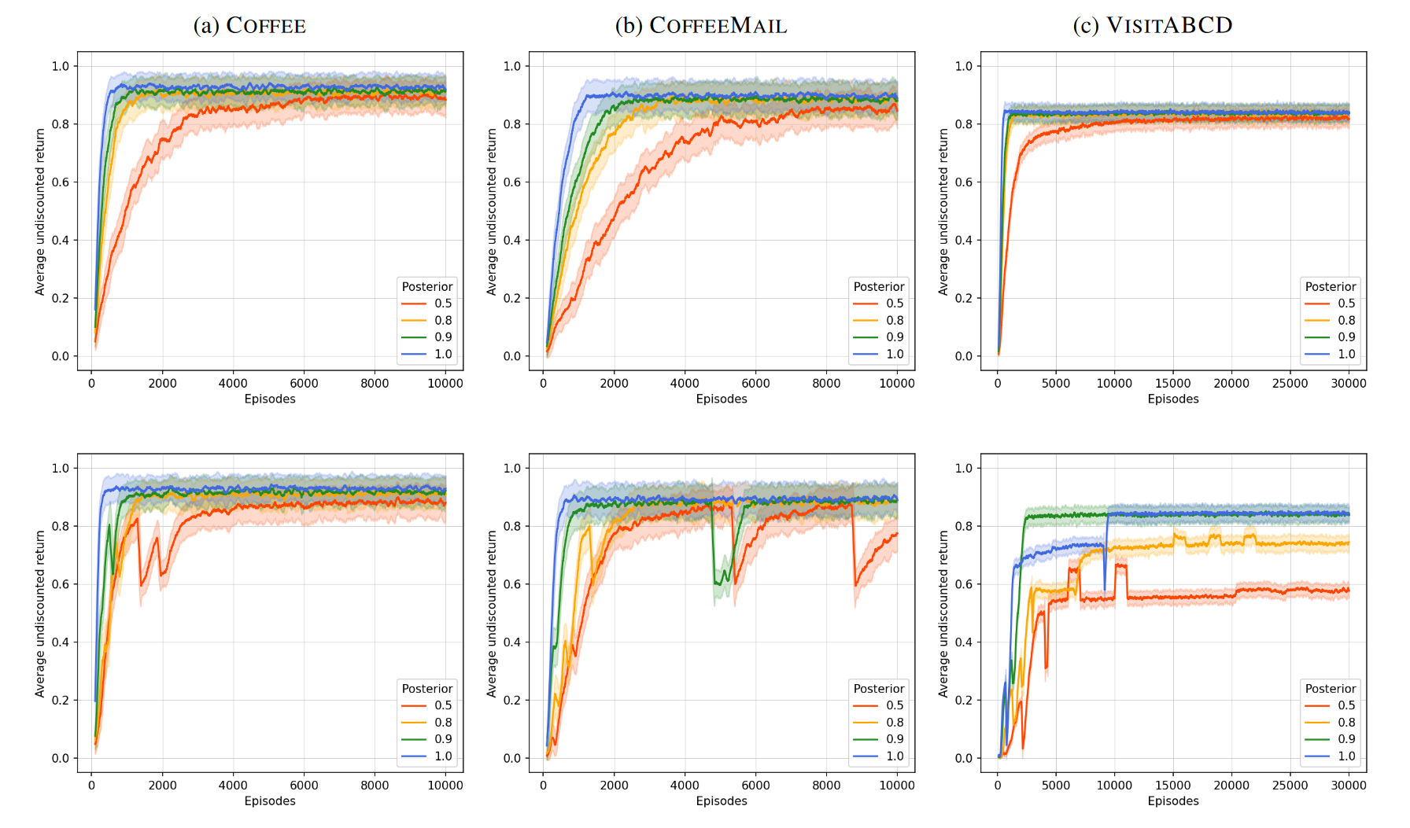
Experiment
Handcrafted RMs
PROB-IRM

Slide 18
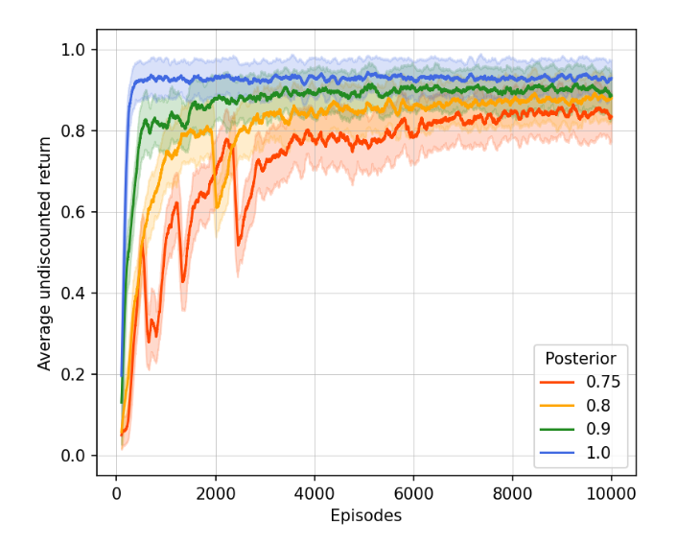
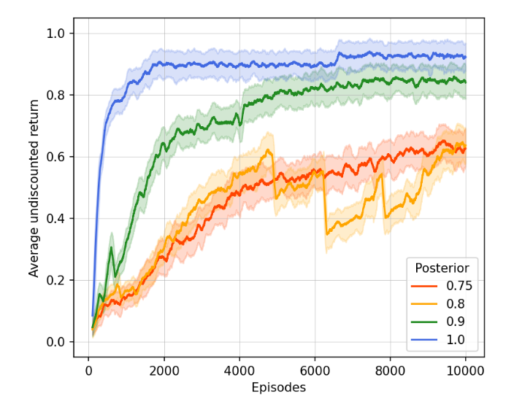
Ablation Studies: Reward Shaping
reward shaping
without reward shaping

